Slide 1


Electronic Safe Using Arduino
INTERNET OF THINGS
Mohammed Mujeer Ulla-Asst. Prof-CSE

Slide 2

Team members
SAI CHARAN KV
-Lead
20191COM0092
KEERTHAN ND
20191COM0098
B MANIKANTA LOKESH
20191COM0035
D SRI SAI ABHIRAM
20191COM0053
K GIFTY AMULYA
20191COM0088
J BHUPATHI NARENDRA
20191COM0079

Slide 3

AIM
TO IMPLEMENT A LOCKER DEVICE WITH HELP OF ARDUINO UNO

Slide 4
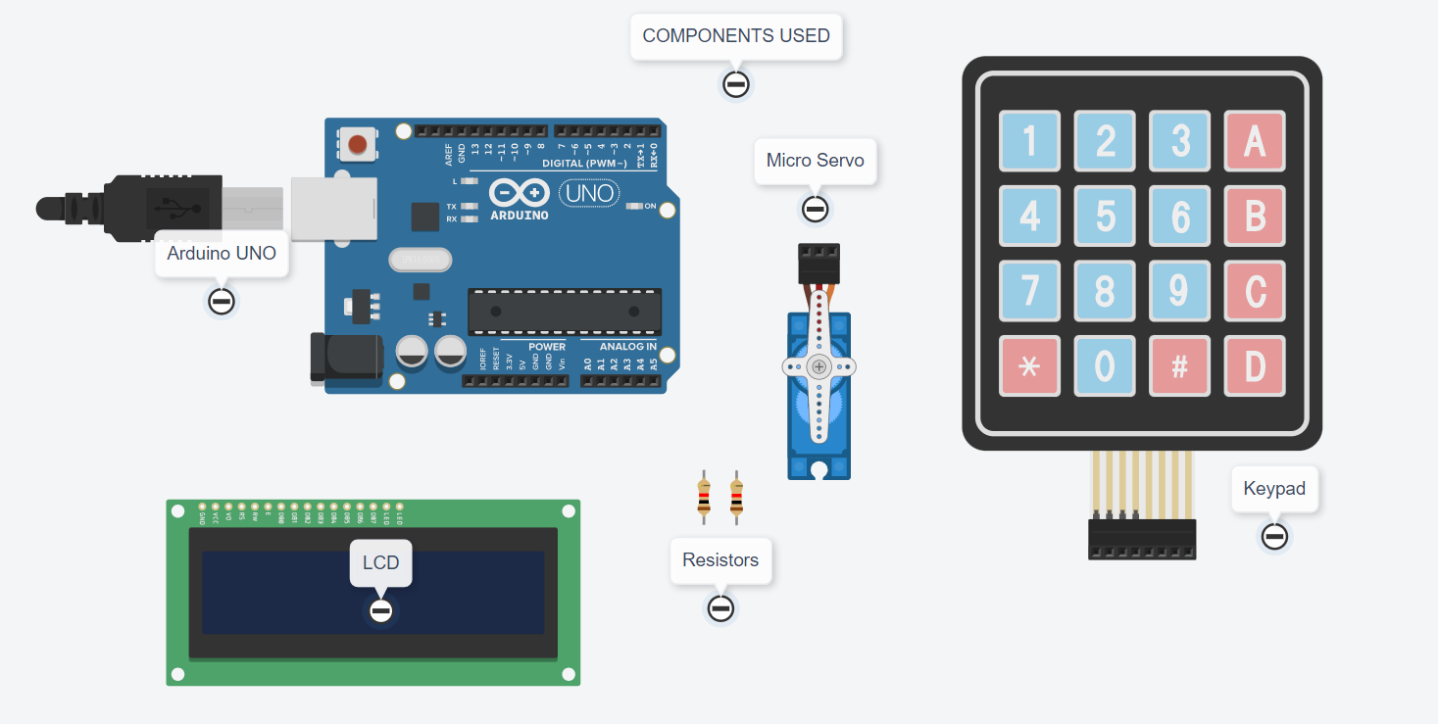
COMPONENTS USED IN PROJECT

Slide 5
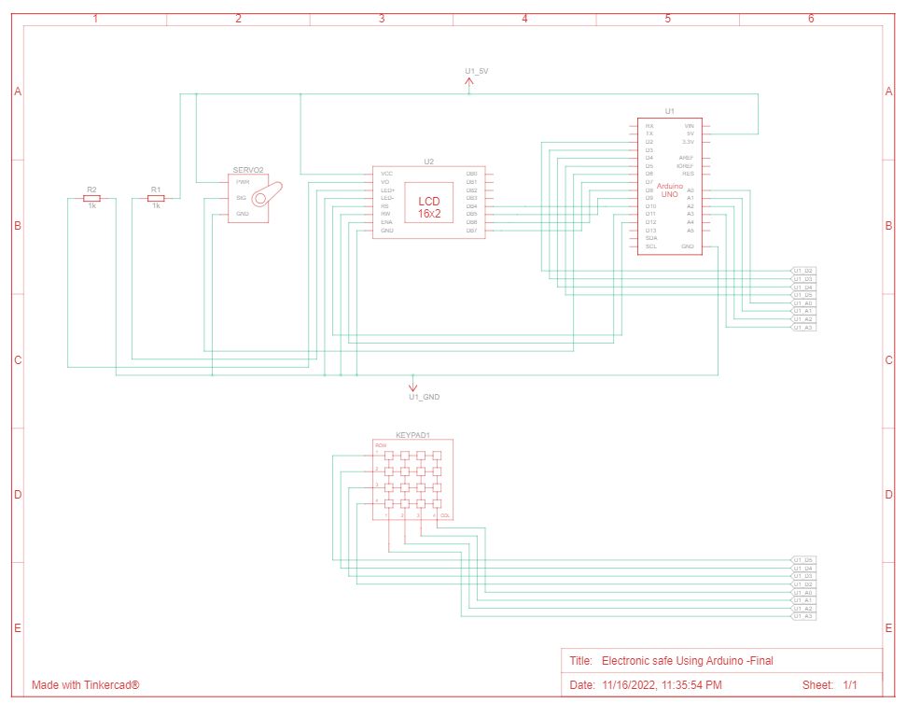
Architecture

Slide 6
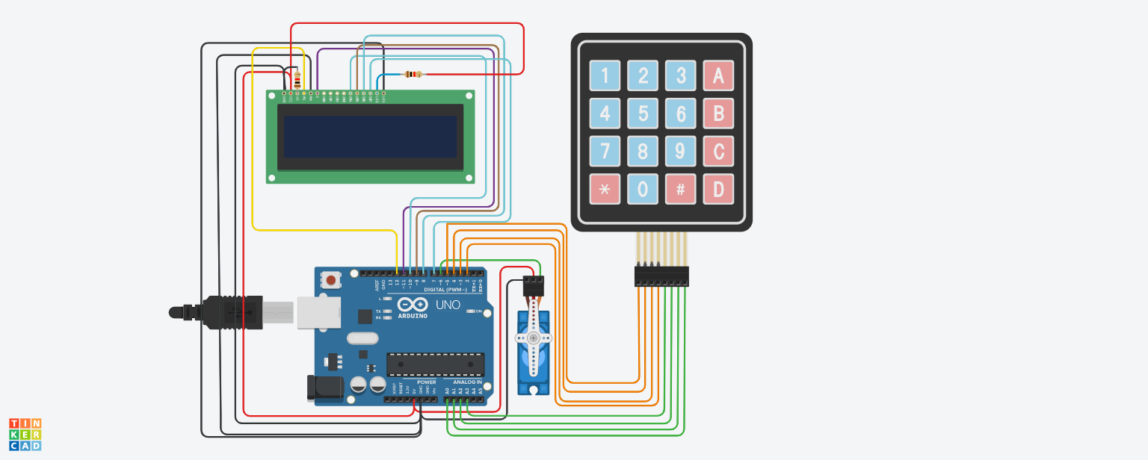
SIMULATION

Slide 7

CONCLUSION
In an ever-changing world, technological advances can work to our advantage or disadvantage, and this is certainly true when it comes to modern features and security safes.
Here is the One of the best things about an electronic lock is how easy it is to open your safe. If you are faced with an emergency situation and need to get into your safe immediately, your electronic lock is usually more reliable speed-wise than a traditional mechanical locking system.

Slide 8


